Slide 1

Data Mining
represented by:
Aleksandra Petkova - S6222041
Nour Aldin ALMUBARAK- p4302185
Victor Essien-W9104119

Slide 2
Datasets
Online Retail: time series, transactional data – 8 attributes, 541K records
Each row represents a whole sale purchase of an item along with details about the purchase such as: the invoice ID, stock code, item description, quantity purchased, price per unit, the ID and country of the customer who made the purchase.
Groceries: customer recite data – 9K records
Each row represents a customer recite (list of the items bought) with no details about the purchase but the names of the items.
MovieLens: movie rating data – 100K records Each row represents one review by one customer.
Notes:
Add notes

Slide 3
Techniques
Association Rules Mining, Apriori
Algorithm
Questions
Results
Collaborative Filtering
Algorithm
Questions
Results
SOME RELATED IMAGES HERE
Notes:
Add notes

Slide 4
Association Rules Mining
Apriori Algorithm is one of many algorithms for Association Rules Mining, other popular examples are the Eclat Algorithm, OPUS Search and FP-growth algorithm. We chose to work with Apriori because it is a standard and simple method for association rules mining and is also the one we are most familiar with.
- Online Retail – Used for both the algorithm written from scratch and the algorithm written with the MLextend Library.
- Groceries – Much smaller dataset, no cleaning required, very simple to work with when building an Association Rules Mining algorithm.
Notes:
Add notes

Slide 5
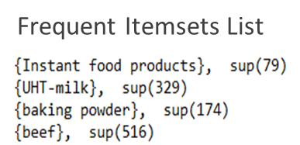
Questions
How many unique items are there?
Which items are very often bought together
Are there any associations in the dataset/s with high confidence?
How many association rules have high confidence?
Rules List

Slide 6
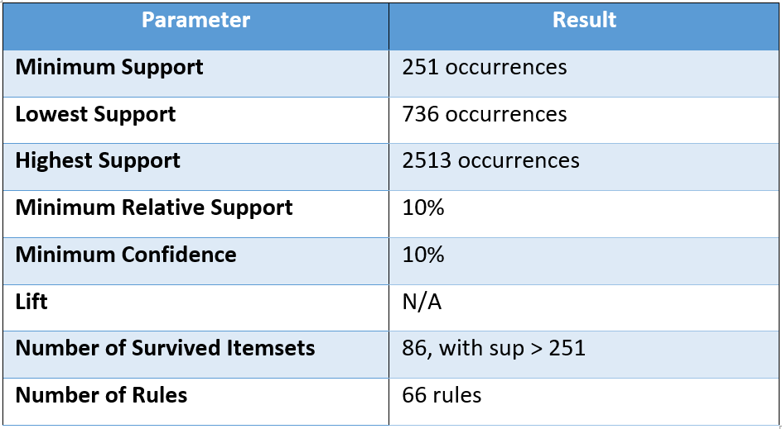
Results - Grocery Shopping Association Rules
169 unique items, with highest frequency 2513 for whole milk and lowest frequency – 1 for baby food.
When given 10% relative support and 10% confidence barrier, the lowest support that passes the boundary is 736, with 86 unique itemsets and 66 unique associations between them.
Highest and Lowest Frequency Items
Notes:
There are 169 unique items discovered by the Apriori algorithm, out of which thousands of rules were generated.

Slide 7
Collaborative Filtering
Collaborative Filtering (Library)
Surprise library has been developed to make recommendation based on Collaborative filtering to predict user rating for a movie, also Nearest neighbour it’s a popular approach.In this data set we used Surprise library since it has default implementation for a variety of CF algorithms.
- Movielands: This dataset (ml-latest-small) describes 5-star rating a movie recommendation service. It contains 100836 ratings and 3683 tag applications across 9742 movies. These data were created by 610 users between March 29, 1996 and September 24, 2018. This dataset was generated on September 26, 2018.Users were selected at random for inclusion. All selected users had rated at least 20 movies. No demographic information is included. Each user is represented by an id, and no other information is provided.

Slide 8
Questions
Find the average rating and number of ratings for the movie?
Find the predicted rating?

Slide 9
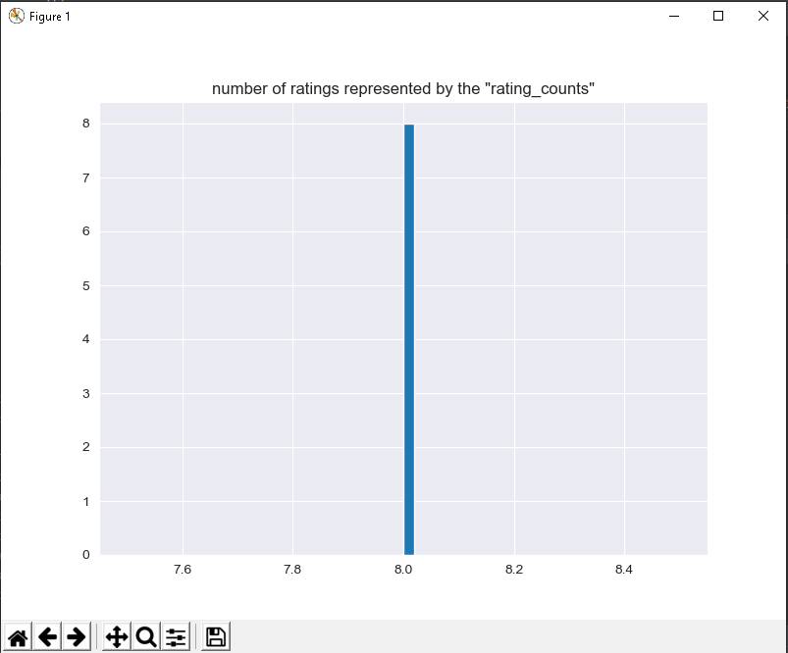
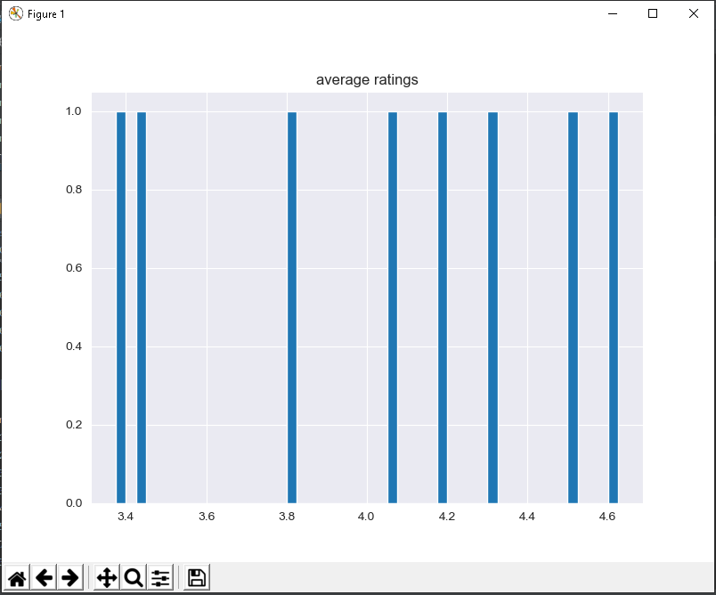
Results – Movie Ratings
average ratings.
number of ratings represented by the "rating_counts

Slide 10
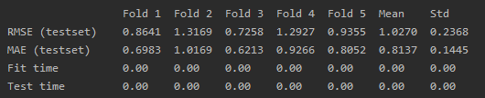
Results – Cross Validation and Predictions
Optimization:
Predicting:

